Slide 1
Chapter 1
Fundamentals of
Algorithm Efficiency Analysis

Slide 2
Mathematical Analysis of Non-recursive Algorithms

Slide 3

Guideline for Analyzing Time Efficiency of Non-recursive Algorithms:
Decide on a parameter (or parameters) indicating an input’s size.
2. Identify the algorithm’s basic operation. (As a rule, it is located in its innermost loop.)
3. Check whether the number of times the basic operation is executed depends only on the size of an input.
If it also depends on other additional property, then investigate the worst-case (O), best-case ( Ω), and, if necessary, average-case (Θ ) efficiencies.
4. Set up a sum expressing the number of times the algorithm’s basic operation is executed.
Using standard formulas and rules of sum manipulation (summations),
either find a closed-form formula for the count
or, at the very least, establish its order of growth.

Slide 4

Mathematical Analysis of Nonrecursive Algorithms
Example 1.22: MaxElement(A[0..n-1])
Assume that a given list of n numbers is implemented as a array A[0..n-1].
Find the value of the largest elements in a list of n numbers.
Algorithm MaxElement( A[0 .. n-1] )
//Determines the value of the largest element in a given array.
Input: An array A[0 .. n-1] of real numbers
Output: The value of the largest element in A
maxVal ← A[0];
for (i ← 1 to n – 1) do {
{ if (A[i] > maxVal)
maxVal ← A[i];}
return maxVal; }

Slide 5
Analysis Framework (in analyzing non-recursive algorithm):
Measuring an input’s size (decide on a parameter(s) indicating an input size):
The number of n elements in the array.
Units for measuring running time (identify the algorithm’s basic operation.
As a rule, it is located in its inner-most loop):
In the for-loop body, we have two operations
a. the comparison operation A[i] > maxVal and
b. the assignment operation maxVal ← A[i]
The basic operation for this algorithm is
the comparison operation A[i] > maxVal,
since the comparison operation is executed for each repetition of the loop
but not the assignment operation.

Slide 6
Analysis Framework (in analyzing non-recursive algorithm):
Check whether the number of times the basic operation is executed depends only on the size of an input.
If it also depends on some additional property, then investigate separately
the worst-case (O),
average-case (Θ ), and if necessary,
best-case ( Ω)
efficiencies.
4. Set up a sum expression the number of times the algorithm’s basic operation is executed.
5. Using standard formulas and rules of sum manipulation, either find a closed form formula for the count or, at the very least, establish its order of growth.

Slide 7
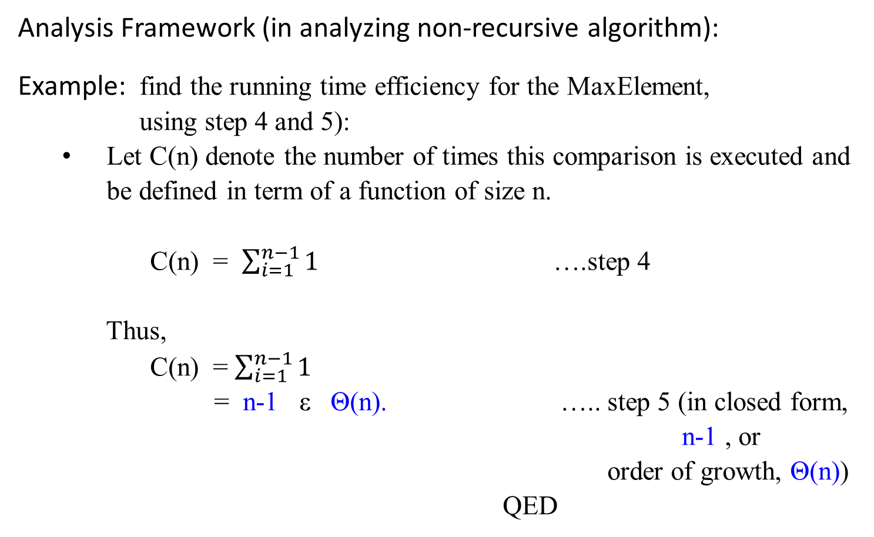
Analysis Framework (in analyzing non-recursive algorithm):
Example: find the running time efficiency for the MaxElement, using step 4 and 5):
Let C(n) denote the number of times this comparison is executed and be defined in term of a function of size n.
C(n) = $\sum_{i=1}^{n−1}{1}$ ….step 4
Thus,
C(n) = $\sum_{i=1}^{n−1}{1}$
= n-1 ε Θ(n). ….. step 5 (in closed form, n-1 , or
order of growth, Θ(n))
QED

Slide 8
Mathematical Analysis of Recursive Algorithms
Methods for Solving Recurrence Relations of Given Recursive Algorithms

Slide 9

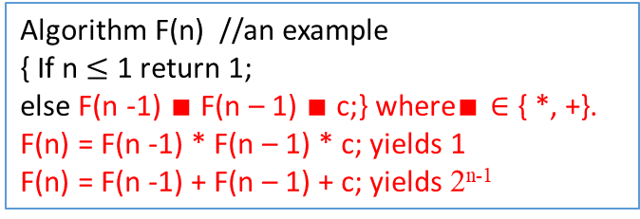
Algorithm F(n) //an example
{ If n $≤$ 1 return 1;
else F(n -1) $∎$ F(n – 1) $∎$ c;} where$∎∈$ { *, +}.
F(n) = F(n -1) * F(n – 1) * c; yields 1
F(n) = F(n -1) + F(n – 1) + c; yields 2^{n-1}
Methods for Solving Recurrence Relations
Method of forward substitutions: (An overview)
Consider the following recurrence equation (or recurrence relation or simply a recurrence) with initial condition:
T(n) = 2T(n-1) + 1, for n > 1
T(1) = 1.
Applying this given recurrence relation, the first few terms are as follows:
T(1) = 1
T(2) = 2T(1) + 1 = 2*1 + 1 = 3
T(3) = 2T(2) + 1 = 2*3 + 1 = 7
T(4) = 2T(3) + 1 = 2*7 + 1 = 15
…
T(n) = 2^{n} – 1 for n = 1, 2, 3, …
F(5)
F(4) * F(4)
F(3) * F(3) F(3) * F(3)
F(2) * F(2) F(2) * F(2) F(2) * F(2) F(2) * F(2)
F(1) * F(1) F(1) * F(1) F(1) * F(1) F(1) * F(1) F(1) * F(1) F(1) * F(1) F(1) * F(1) F(1) * F(1)
0
1
2
4
8

Slide 10

Methods for Solving Recurrence Relations
Method of forward substitutions: (An overview)
Obviously, these numbers are one less than consecutive powers of 2 :
T(n) = 2^{n} – 1 for n = 1, 2, 3, …
Show that this formula yields the generic term of the solution to the given recurrence equation with the initial condition
either by direct substitution of the formula into
the given equation with the initial condition
or by mathematical induction.
The method of forward substitutions works in a very limited number of cases because it is usually very difficult to recognize the pattern in the first few terms of the sequence.

Slide 11

Methods for Solving Recurrence Relations
Method of forward substitutions: (An overview)
Given: T(n) = 2T(n-1) + 1, for n > 1
T(1) = 1.
[Proof by mathematical induction: T(n) = 2^{n} – 1 for n = 1, 2, 3, …]
When n = 1, then T(n) = 2^{n} – 1 becomes T(1) = 2¹ - 1 = 1.
Assume that T(i) = 2^{i} – 1 is true for some i.
Then, T(i + 1) = 2 T((i + 1) – 1) + 1, given equation.
= 2 T(i) +1, simplification.
= 2 (2^{i} – 1 ) + 1, assumption: T(i) = 2^{i} – 1.
= (2^{i+1} – 2 ) + 1
= 2^{i+1} – 1. QED.

Slide 12

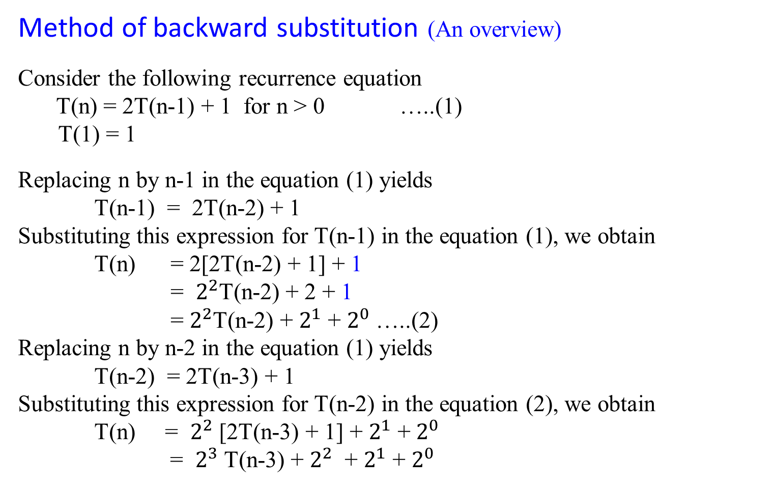
Method of backward substitution (An overview)
Consider the following recurrence equation
T(n) = 2T(n-1) + 1 for n > 0 …..(1)
T(1) = 1
Replacing n by n-1 in the equation (1) yields
T(n-1) = 2T(n-2) + 1
Substituting this expression for T(n-1) in the equation (1), we obtain
T(n) = 2[2T(n-2) + 1] + 1
= $2^{2}$T(n-2) + 2 + 1
= $2^{2}$T(n-2) + $2^{1}$ + $2^{0}$…..(2)
Replacing n by n-2 in the equation (1) yields
T(n-2) = 2T(n-3) + 1
Substituting this expression for T(n-2) in the equation (2), we obtain
T(n) = $2^{2}$[2T(n-3) + 1] + $2^{1}$ + $2^{0}$
= $2^{3}$T(n-3) + $2^{2}$ + $2^{1}$ + $2^{0}$

Slide 13
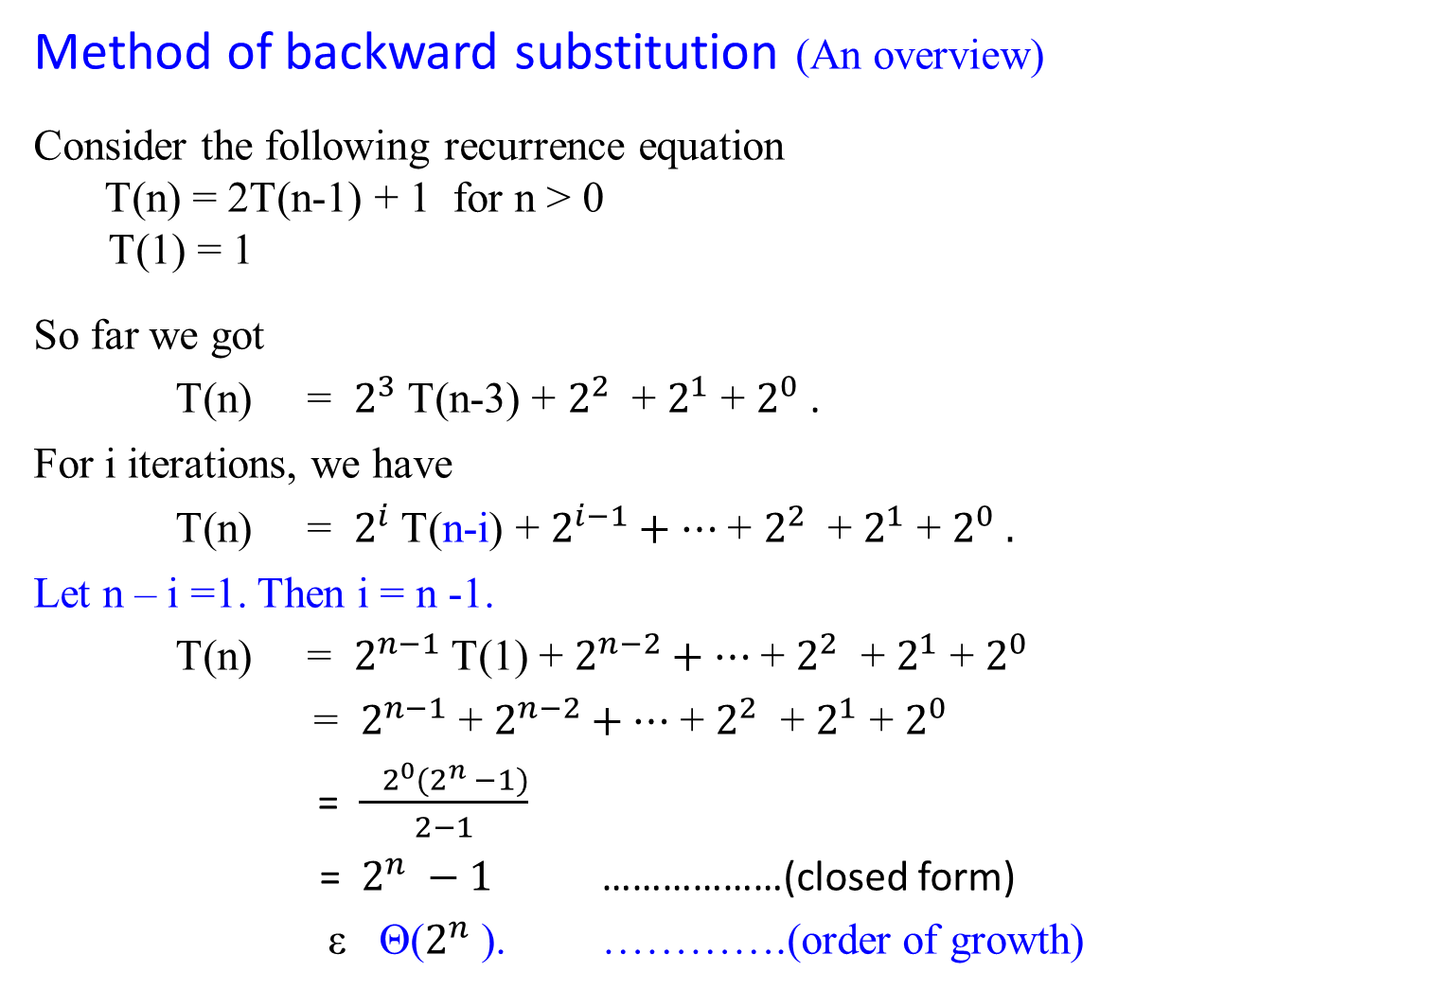
Method of backward substitution (An overview)
Consider the following recurrence equation
T(n) = 2T(n-1) + 1 for n > 0
T(1) = 1
So far we got
T(n) = $2^{3}$T(n-3) + $2^{2}$ + $2^{1}$ + $2^{0}$.
For i iterations, we have
T(n) = $2^{i}$T(n-i) + $2^{i−1}+…$+ $2^{2}$ + $2^{1}$ + $2^{0} .$
Let n – i =1. Then i = n -1.
T(n) = $2^{n−1}$T(1) + $2^{n−2}+…$+ $2^{2}$ + $2^{1}$ + $2^{0}$
= $2^{n−1}$ + $2^{n−2}+…$+ $2^{2}$ + $2^{1}$ + $2^{0}$
= $\frac{ 2^{0}(2^{n} −1)}{2−1}$
= $2^{n} −1$ ………………(closed form)
ε Θ($2^{n}$). ………….(order of growth)

Slide 15

Method of backward substitution (An overview)
Consider the following recurrence equation
T(n) = T(n-1) + n for n > 0 …..(1)
T(0) = 0
Replacing n by n-1 in the equation (1) yields
T(n-1) = T(n-2) + n - 1
Substituting this expression for T(n-1) in the equation (1), we obtain
T(n) = [T(n-2) + n-1] + n
= T(n-2) +(n-1) + n …..(2)
Replacing n by n-2 in the equation (1) yields
T(n-2) = T(n-3) + n-2
Substituting this expression for T(n-2) in the equation (2), we obtain
T(n) = [T(n-3) + n-2 ] + (n-1) + n
= T(n-3) + (n-2) + (n-1) + n

Slide 16

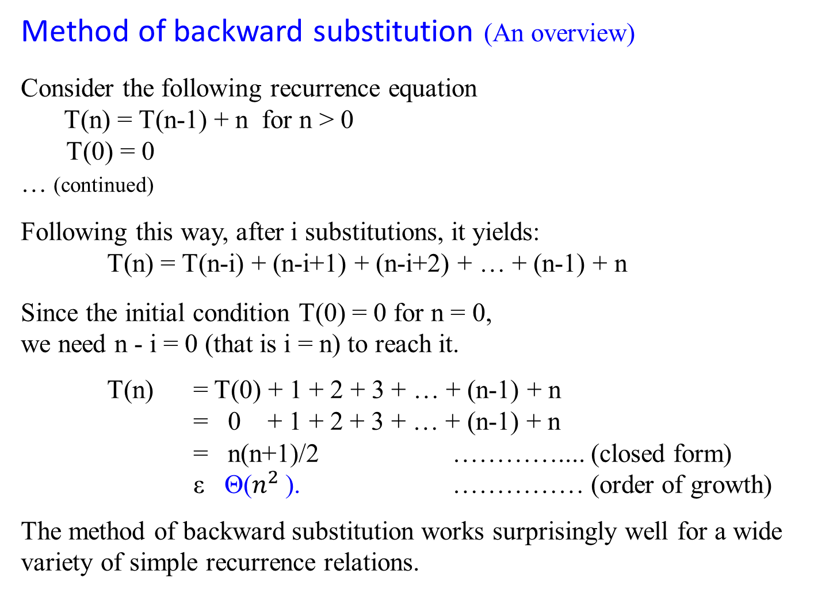
Method of backward substitution (An overview)
Consider the following recurrence equation
T(n) = T(n-1) + n for n > 0
T(0) = 0
… (continued)
Following this way, after i substitutions, it yields:
T(n) = T(n-i) + (n-i+1) + (n-i+2) + … + (n-1) + n
Since the initial condition T(0) = 0 for n = 0,
we need n - i = 0 (that is i = n) to reach it.
T(n) = T(0) + 1 + 2 + 3 + … + (n-1) + n
= 0 + 1 + 2 + 3 + … + (n-1) + n
= n(n+1)/2 ………….... (closed form)
ε Θ($n^{2}$). …………… (order of growth)
The method of backward substitution works surprisingly well for a wide variety of simple recurrence relations.
T(1) = T(0) + 1 = 1;
T(2) = T(1) + 2 = 1 + 2 = 3;
T(3) = T(2) + 3 = 2 + 3 = 6
T(4) = T(3) + 4 = 6 +4 = 10
T(5) = T(4) + 5 = 10 + 5 =15
T(6) = T(5) + 6 = 15 + 6 = 21
T(n) = 0 + 1 + 3 + 6 + 10 + 15 + 21 + 28 + 36 + 45 + …
T(n) = ?
Answer: T(n) = $\frac{n(n+1)}{2}$
Is this easy to conclude it?

Slide 17

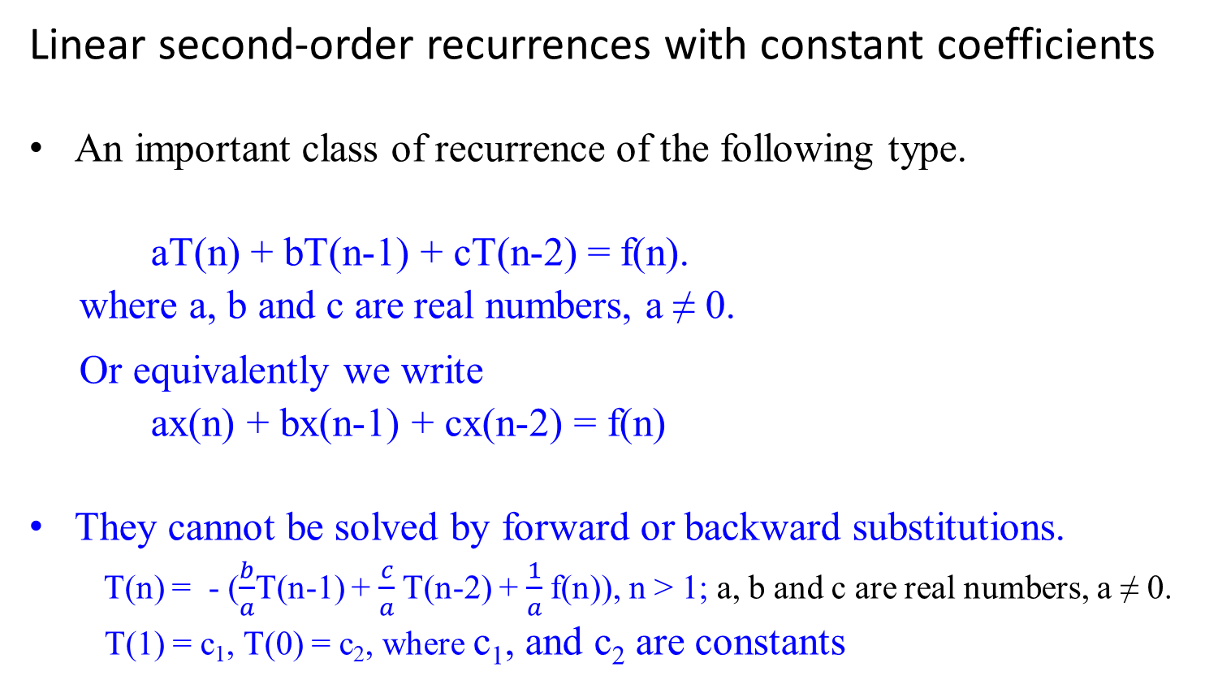
Linear second-order recurrences with constant coefficients
An important class of recurrence of the following type.
aT(n) + bT(n-1) + cT(n-2) = f(n).
where a, b and c are real numbers, a ≠ 0.
Or equivalently we write
ax(n) + bx(n-1) + cx(n-2) = f(n)
They cannot be solved by forward or backward substitutions.
T(n) = - ($\frac{b}{a}$T(n-1) + $\frac{c}{a}$T(n-2) + $\frac{1}{a}$f(n)), n > 1; a, b and c are real numbers, a ≠ 0.
T(1) = c₁, T(0) = c₂, where c₁, and c₂ are constants

Slide 18

Linear second-order recurrences with constant coefficients
aT(n) + bT(n-1) + cT(n-2) = f(n)
where a, b and c are real numbers, a ≠ 0.
The recurrence is:
second-order because the elements T(n) and T(n-2) are two positions apart in the unknown sequence in questions.
linear because the left-hand side is a linear combination of the unknown terms of the sequence.
constant coefficients where a, b, and c are assuming to be some fixed number.
It is homogeneous, if f(n) = 0 for every n; otherwise, it is called inhomogeneous.
This recurrence is called second-order linear recurrence with constant coefficients.

Slide 19

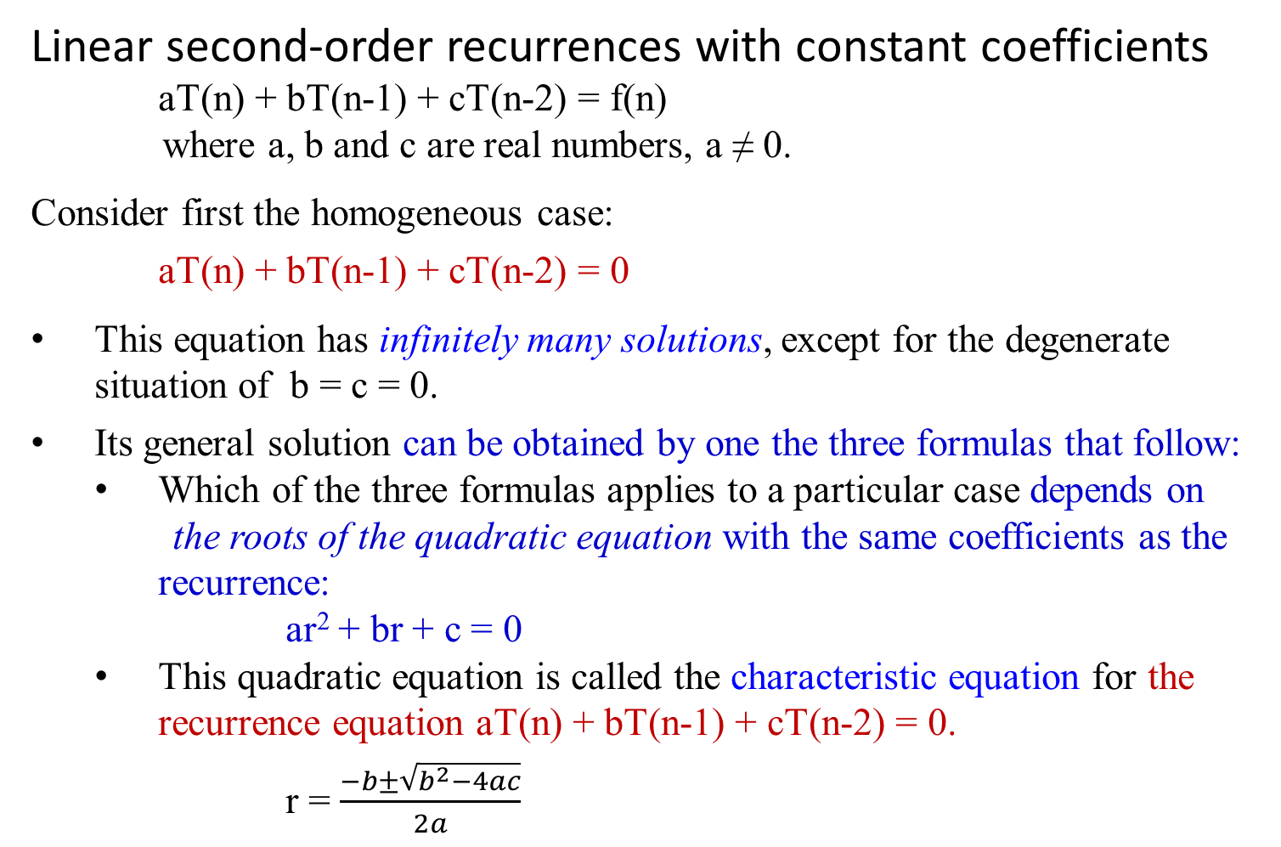
Linear second-order recurrences with constant coefficients
aT(n) + bT(n-1) + cT(n-2) = f(n)
where a, b and c are real numbers, a ≠ 0.
Consider first the homogeneous case:
aT(n) + bT(n-1) + cT(n-2) = 0
This equation has infinitely many solutions, except for the degenerate situation of b = c = 0.
Its general solution can be obtained by one the three formulas that follow:
Which of the three formulas applies to a particular case depends on
the roots of the quadratic equation with the same coefficients as the recurrence:
ar² + br + c = 0
This quadratic equation is called the characteristic equation for the recurrence equation aT(n) + bT(n-1) + cT(n-2) = 0.
r = $\frac{−b±\sqrt{b^{2}−4ac}}{2a}$

Slide 20

Theorem 1.4: Let r₁, r₂ be two roots of characteristic equation
ar² + br + c = 0
for recurrence relation aT(n) + bT(n-1) + cT(n-2) = 0.
Case 1: If r₁ and r₂ are real and distinct, the general solution to the recurrence relation is obtained by the formula
T(n) = α r₁^{n} + β r₂^{n}
where α and β are two arbitrary real constants.
Case 2: …

Slide 21

Theorem 1.4: Let r₁, r₂ be two roots of characteristic equation
ar² + br + c = 0
for recurrence relation aT(n) + bT(n-1) + cT(n-2) = 0.
Case 1: …
Case 2: If r₁ and r₂ are equal to each other, the general solution to
the recurrence relation is obtained by the formula
T(n) = α r^{n} + β n r^{n}
where r = r₁ = r₂, and α and β are two arbitrary real constants.
Case 3: …

Slide 22
Theorem 1.4: Let r₁, r₂ be two roots of characteristic equation
ar² + br + c = 0
for recurrence relation aT(n) + bT(n-1) + cT(n-2) = 0.
Case 1: ..
Case 2: …
Case 3: If r_{1, 2} = u + i v are two distinct complex numbers, the
general solution to the recurrence relation is obtained by the
formula
T(n) = γ^{n}[α cos nθ + β sin nθ]
where γ = √(u² + v²) and θ = arctan v/u, and α and β are
two arbitrary real constants.

Slide 23

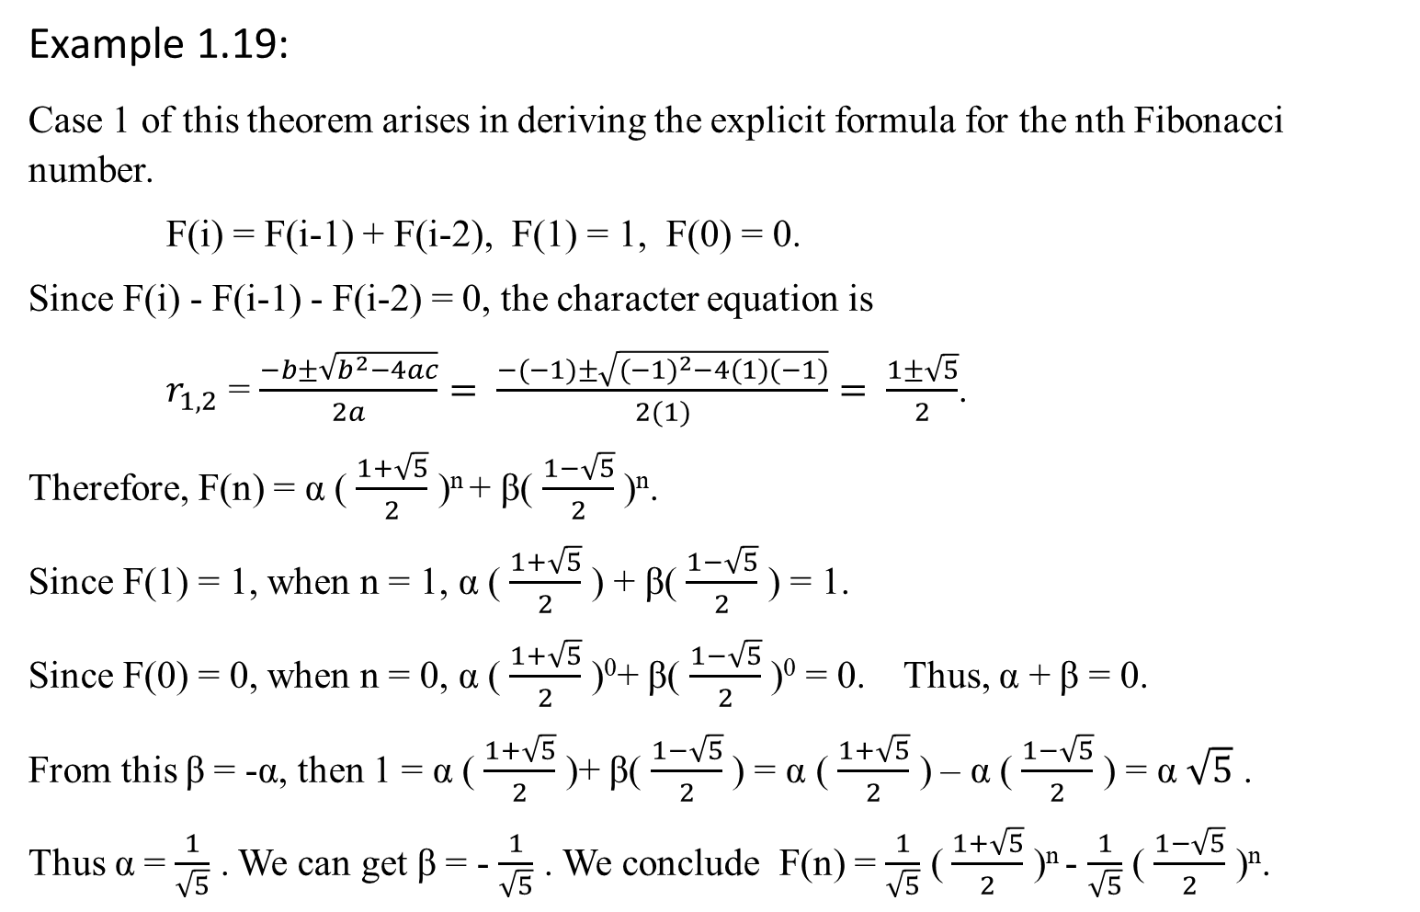
Example 1.19:
Case 1 of this theorem arises in deriving the explicit formula for the nth Fibonacci number.
F(i) = F(i-1) + F(i-2), F(1) = 1, F(0) = 0.
Since F(i) - F(i-1) - F(i-2) = 0, the character equation is
$r_{1,2}$ = $\frac{−b±\sqrt{b^{2}−4ac}}{2a}= \frac{−(−1)±\sqrt{{(−1)}^{2}−4(1)(−1)}}{2(1)}= \frac{1±\sqrt{5}}{2}$.
Therefore, F(n) = α ( $\frac{1+\sqrt{5}}{2}$ )^{n} + β( $\frac{1−\sqrt{5}}{2}$ )^{n}.
Since F(1) = 1, when n = 1, α ( $\frac{1+\sqrt{5}}{2}$ ) + β( $\frac{1−\sqrt{5}}{2}$ ) = 1.
Since F(0) = 0, when n = 0, α ( $\frac{1+\sqrt{5}}{2}$ )⁰+ β( $\frac{1−\sqrt{5}}{2}$ )⁰ = 0. Thus, α + β = 0.
From this β = -α, then 1 = α ( $\frac{1+\sqrt{5}}{2}$ )+ β( $\frac{1−\sqrt{5}}{2}$ ) = α ( $\frac{1+\sqrt{5}}{2}$ ) – α ( $\frac{1−\sqrt{5}}{2}$ ) = α $\sqrt{5}$ .
Thus α = $\frac{1}{\sqrt{5}}$ . We can get β = - $\frac{1}{\sqrt{5}}$ . We conclude F(n) = $\frac{1}{\sqrt{5}}$ ( $\frac{1+\sqrt{5}}{2}$ )^{n} - $\frac{1}{\sqrt{5}}$ ( $\frac{1−\sqrt{5}}{2}$ )^{n}.

Slide 24
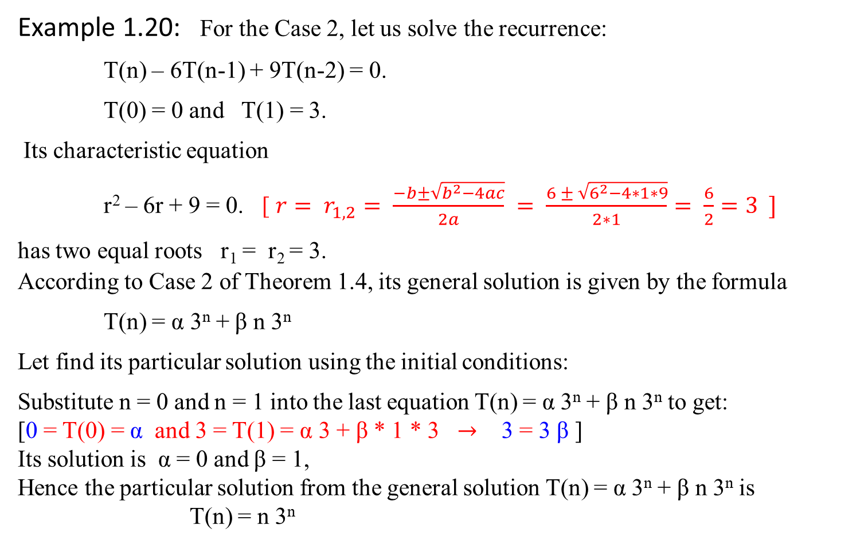
Example 1.20: For the Case 2, let us solve the recurrence:
T(n) – 6T(n-1) + 9T(n-2) = 0.
T(0) = 0 and T(1) = 3.
Its characteristic equation
r² – 6r + 9 = 0. [ ${r= r}_{1,2}= \frac{−b±\sqrt{b^{2}−4ac}}{2a} = \frac{6 ± \sqrt{6^{2}−4∗1∗9}}{2∗1}= \frac{6}{2}=3 ]$
has two equal roots r₁ = r₂ = 3. According to Case 2 of Theorem 1.4, its general solution is given by the formula
T(n) = α 3^{n} + β n 3^{n}
Let find its particular solution using the initial conditions:
Substitute n = 0 and n = 1 into the last equation T(n) = α 3^{n} + β n 3^{n} to get:
[0 = T(0) = α and 3 = T(1) = α 3 + β * 1 * 3 $→$ 3 = 3 β ]
Its solution is α = 0 and β = 1,
Hence the particular solution from the general solution T(n) = α 3^{n} + β n 3^{n} is
T(n) = n 3^{n}

Slide 25
Now consider the case of inhomogeneous linear second-order recurrences with constant coefficients.
Theorem 1.5 The general solution to inhomogeneous equation
aT(n) + bT(n-1) + cT(n-2) = f(n)
can be obtained as the sum of the general solution to the corresponding homogeneous equation
aT(n) + bT(n-1) + cT(n-2) = 0
and a particular solution to inhomogeneous equation
aT(n) + bT(n-1) + cT(n-2) = f(n).
Note: Specifically, if f(n) is a nonzero constant, we can look for a particular solution that is a constant as well.

Slide 26


Example 1.21: Find the general solution to the inhomogeneous recurrence
T(n) – 6T(n-1) + 9T(n-2) = 4.
If T(n) = c is its particular solution, constant c must satisfy the above equation
c – 6c + 9c = 4,
which yields c = 1.
The homogeneous equation T(n) – 6T(n-1) + 9T(n-2) = 0
has the general solution,
T(n) = α 3^{n} + β n 3^{n} .
The particular solution to T(n) – 6T(n-1) + 9T(n-2) = 4 is obtained by the formula
T(n) = α 3^{n} + β n 3^{n} + 1.
r = $\frac{−b±\sqrt{b^{2}−4ac}}{2a}$
r = $\frac{6±\sqrt{6^{2}−4∗9}}{2}$
r_{1,2} = 3 (case 2 applied)
What if T(n) – 6T(n-1) + 9T(n-2) = f(n)?

Slide 27

Mathematical Analysis of Recursive Algorithms
Let treat Fibonacci Numbers Recurrence System as homogenous linear second-ordered recurrence with constant coefficients way.
Example 1.23: Fibonacci Numbers
Let rewrite the exponential algorithm function fib1(n) as follows:
Algorithm Fibonacci_Number F(n)
//Using its definition, computes the nth Fibonacci number recursively.
Input: A nonnegative integer n = {0, 1, 2, 3, …, n}
Output: The nth Fibonacci number
if (n ≤ 1) return n;
else return F(n-1) + F(n-2);

Slide 28
Explicit Formula for the nth Fibonacci Number
Given the recurrence
F(n) = F(n-1) + F(n-2) for n > 1
(i.e., F(n) - F(n-1) - F(n-2) = 0, for n > 1)
and two initial conditions
F(0) = 0, F(1) = 1

Slide 29

Comments:
If we apply the method of backward substitution to solve this recurrence relation, we will fail to get an easily discernible pattern.
Instead, since it is homogeneous recurrence, let us take advantage of a Theorem 1.4 that describes solutions to a homogeneous second-order linear recurrence with constant coefficients
aT(n) + bT(n-1) + cT(n-2) = 0
where a, b and c are some fixed real numbers (a ≠ 0) called the coefficients of the recurrence and T(n)’s is the generic term of an unknown sequence to be found.

Slide 30
According to the Theorem 1.4, this recurrence
aT(n) + bT(n-1) + cT(n-2) = 0
has an infinite number of solutions that can be obtained by one the three formulas. Which of the three formulas applies to a particular case depends on the number of real roots of the quadratic equation with the same coefficients as this recurrence:
ar² + br + c = 0
This equation ar² + br + c = 0 is called the characteristic equation for the recurrence aT(n) + bT(n-1) + cT(n-2) = 0.
End of Comments

Slide 31

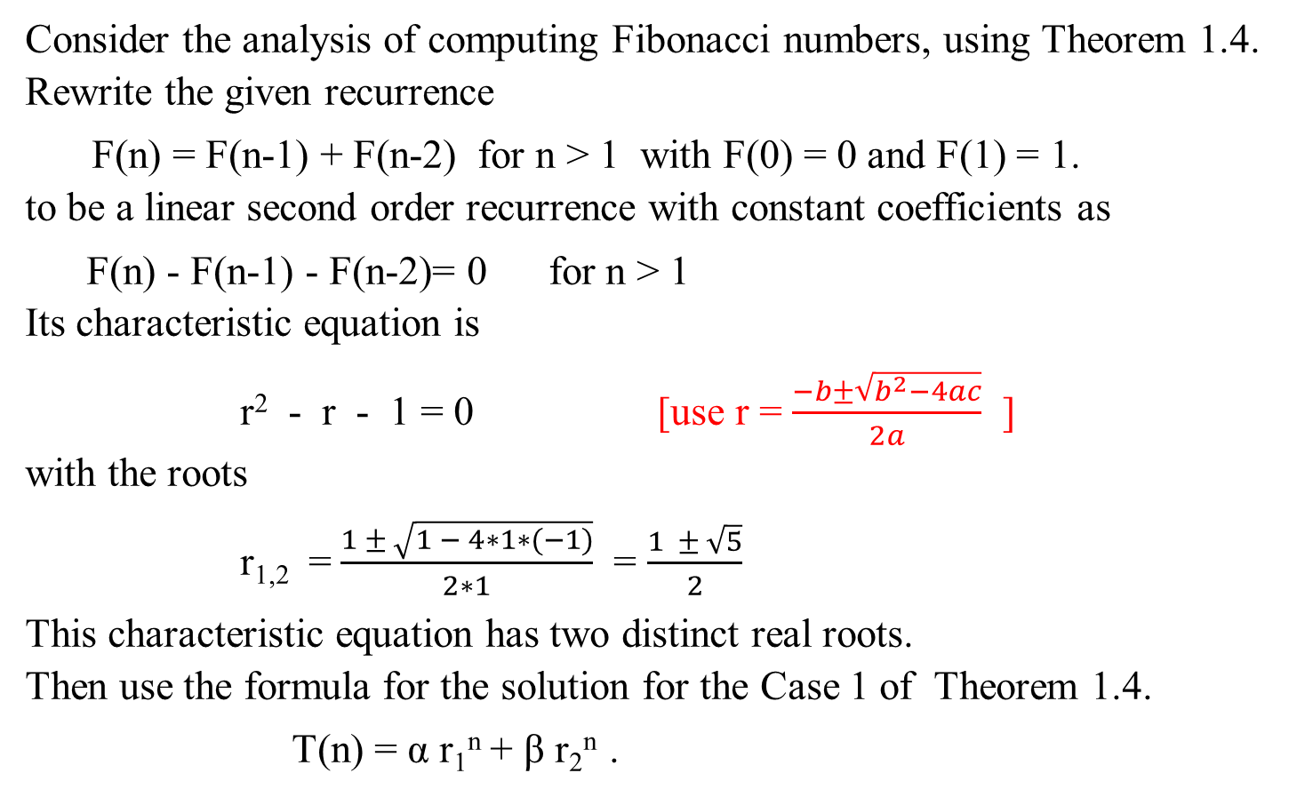
The following is stated in Example 1.19:
Consider the analysis of computing Fibonacci numbers, using Theorem 1.4.
Rewrite the given recurrence
F(n) = F(n-1) + F(n-2) for n > 1 with F(0) = 0 and F(1) = 1.
to be a linear second order recurrence with constant coefficients as
F(n) - F(n-1) - F(n-2)= 0 for n > 1
Its characteristic equation is
r² - r - 1 = 0 [use r = $\frac{−b±\sqrt{b^{2}−4ac}}{2a}$ ]
with the roots
r_{1,2} = $\frac{1 ± \sqrt{1 − 4∗1∗(−1)}}{2∗1}$ = $\frac{1 ± \sqrt{5}}{2}$
This characteristic equation has two distinct real roots. Then use the formula for the solution for the Case 1 of Theorem 1.4.
T(n) = α r₁^{n} + β r₂^{n} .

Slide 32
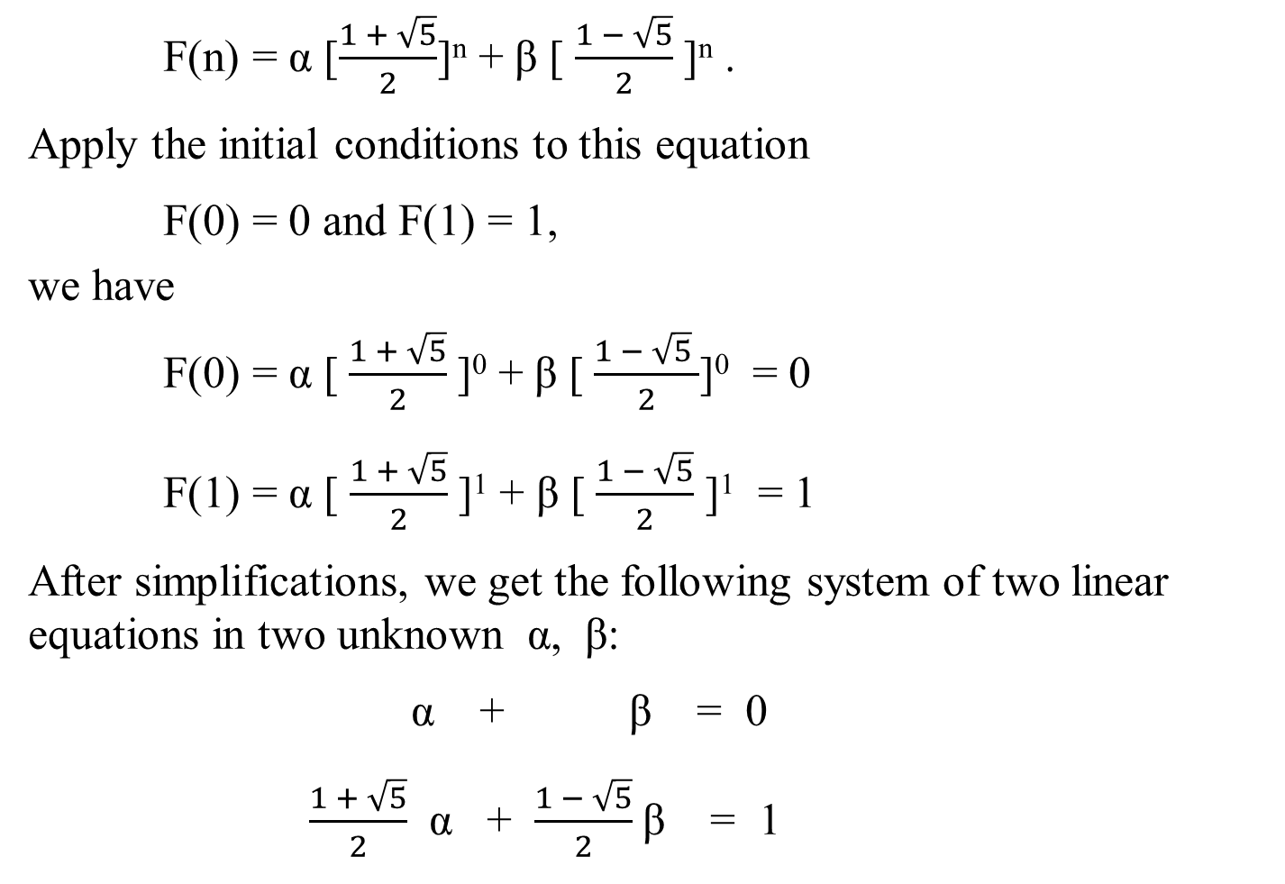
F(n) = α [$\frac{1 + \sqrt{5}}{2}$]^{n} + β [ $\frac{1 − \sqrt{5}}{2}$]^{n} .
Apply the initial conditions to this equation
F(0) = 0 and F(1) = 1,
we have
F(0) = α [$\frac{1 + \sqrt{5}}{2}$]⁰ + β [$\frac{1 − \sqrt{5} }{2}$]⁰ = 0
F(1) = α [ $\frac{1 + \sqrt{5}}{2}$]¹ + β [$\frac{1 − \sqrt{5}}{2}$ ]¹ = 1
After simplifications, we get the following system of two linear equations in two unknown α, β:
α + β = 0
$\frac{1 + \sqrt{5}}{2}$ α + $\frac{1 − \sqrt{5}}{2}$β = 1
Case 1: T(n) = α r₁^{n} + β r₂^{n}

Slide 33
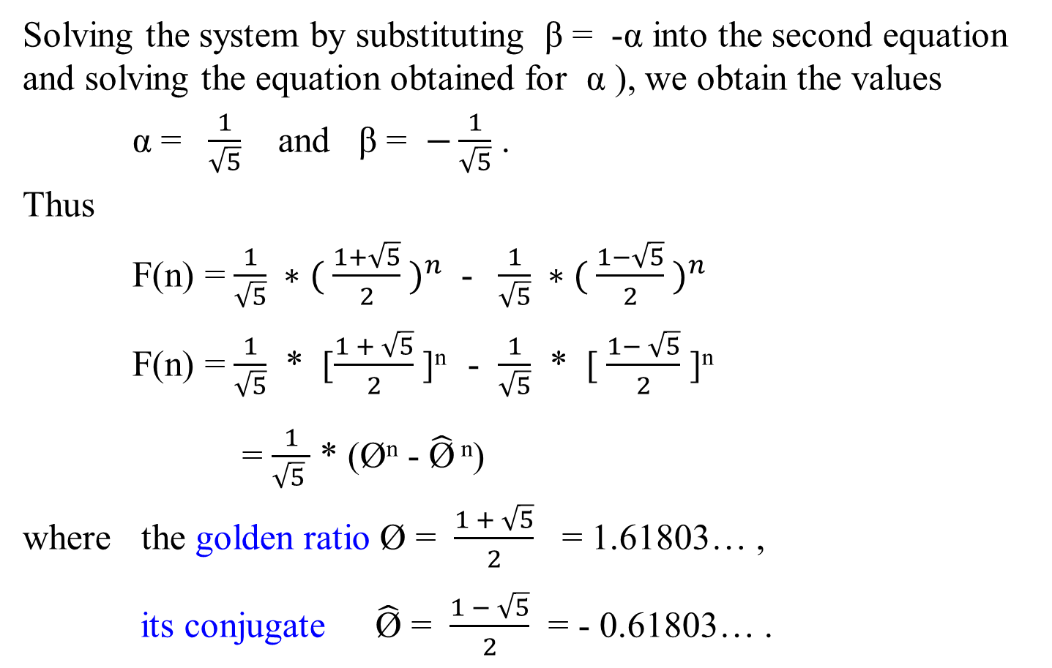
Solving the system by substituting β = -α into the second equation and solving the equation obtained for α ), we obtain the values
α = $\frac{1}{\sqrt{5}}$ and β = $−\frac{1}{\sqrt{5}}$ .
Thus
F(n) = $\frac{1}{\sqrt{5}} ∗( \frac{1+\sqrt{5}}{2} )^{n}$ - $\frac{1}{\sqrt{5}} ∗( \frac{1−\sqrt{5}}{2} )^{n}$
F(n) = $\frac{1}{\sqrt{5}}$ * [$\frac{1 + \sqrt{5}}{2}$]^{n} - $\frac{1}{\sqrt{5}}$ * [$\frac{1− \sqrt{5}}{2}$ ]^{n}
= $\frac{1}{\sqrt{5} }$ * (Ø^{n} - $\hat{\text{Ø}}$ ^{n})
where the golden ratio Ø = $\frac{1 + \sqrt{5}}{2}$ = 1.61803… ,
its conjugate $\hat{\text{Ø}}$ = $\frac{1 − \sqrt{5}}{2}$ = - 0.61803… .

Slide 34

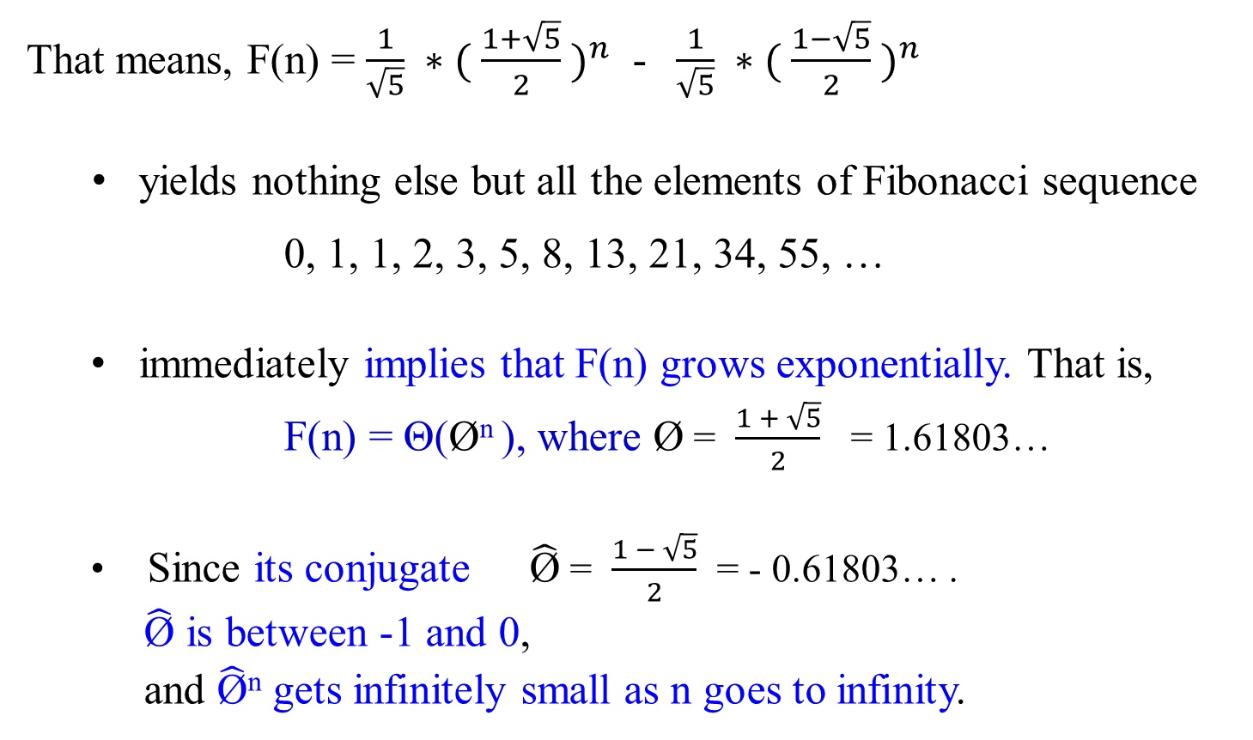
That means, F(n) = $\frac{1}{\sqrt{5}} ∗( \frac{1+\sqrt{5}}{2} )^{n}$ - $\frac{1}{\sqrt{5}} ∗( \frac{1−\sqrt{5}}{2} )^{n}$
yields nothing else but all the elements of Fibonacci sequence
0, 1, 1, 2, 3, 5, 8, 13, 21, 34, 55, …
immediately implies that F(n) grows exponentially. That is,
F(n) = Θ(Ø^{n} ), where Ø = $\frac{1 + \sqrt{5}}{2}$ = 1.61803…
Since its conjugate $\hat{\text{Ø}}$ = $\frac{1 − \sqrt{5}}{2}$ = - 0.61803… .
$\hat{\text{Ø}}$ is between -1 and 0,
and $\hat{\text{Ø}}$^{n} gets infinitely small as n goes to infinity.

Slide 35
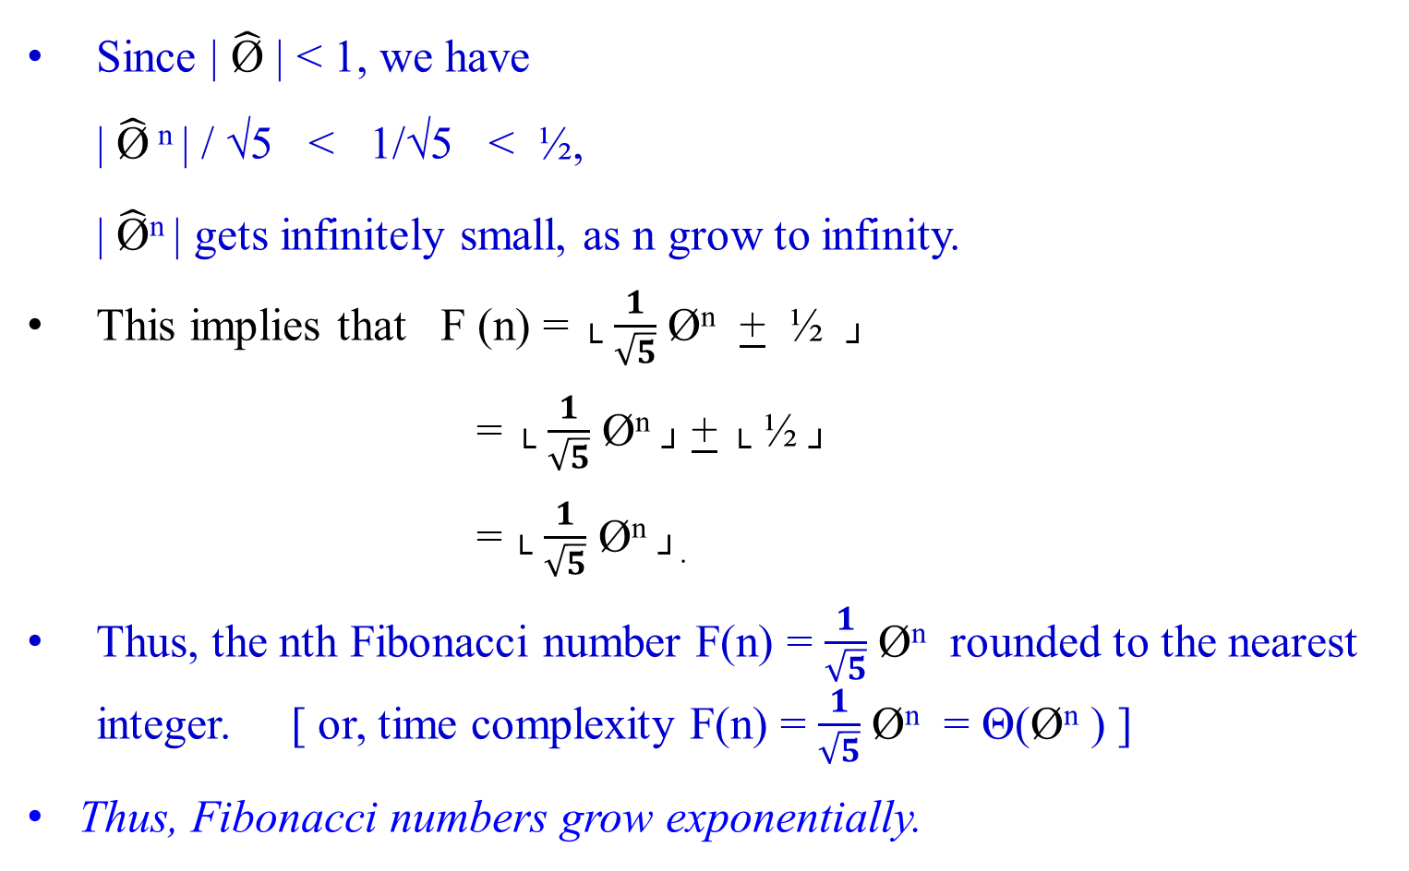
Since | $\hat{\text{Ø}}$ | < 1, we have
| $\hat{\text{Ø}}$ ^{n} | / √5 < 1/√5 < ½,
| $\hat{\text{Ø}}$^{n} | gets infinitely small, as n grow to infinity.
This implies that F (n) = └ $\frac{1}{\sqrt{5}}$ Ø^{n} + ½ ┘
= └ $\frac{1}{\sqrt{5}}$ Ø^{n} ┘ + └ ½ ┘
= └ $\frac{1}{\sqrt{5}}$ Ø^{n} ┘.
Thus, the nth Fibonacci number F(n) = $\frac{1}{\sqrt{5}}$ Ø^{n} rounded to the nearest integer. [ or, time complexity F(n) = $\frac{1}{\sqrt{5}}$ Ø^{n} = Θ(Ø^{n} ) ]
Thus, Fibonacci numbers grow exponentially.

Slide 36

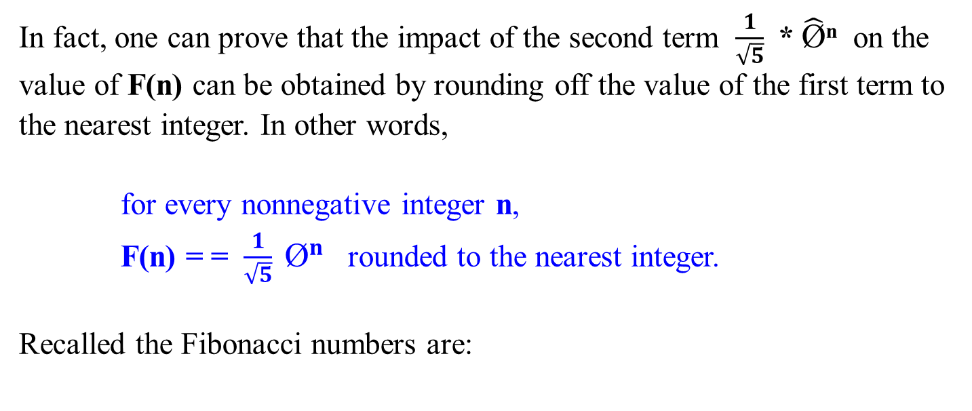
In fact, one can prove that the impact of the second term $\frac{1}{\sqrt{5}}$ * $\hat{\text{Ø}}$^{n} on the value of F(n) can be obtained by rounding off the value of the first term to the nearest integer. In other words,
for every nonnegative integer n,
F(n) = = $\frac{1}{\sqrt{5}} {\text{Ø}}^{n}$ rounded to the nearest integer.
Recalled the Fibonacci numbers are:
k=0 | 1 | 2 | 3 | 4 | 5 | 6 | 7 | 8 | 9 | 10 | 11 | 12 | 13
F=0 | 1 | 1 | 2 | 3 | 5 | 8 | 13 | 21 | 34 | 54 | 88 | 142 | 230

Slide 37
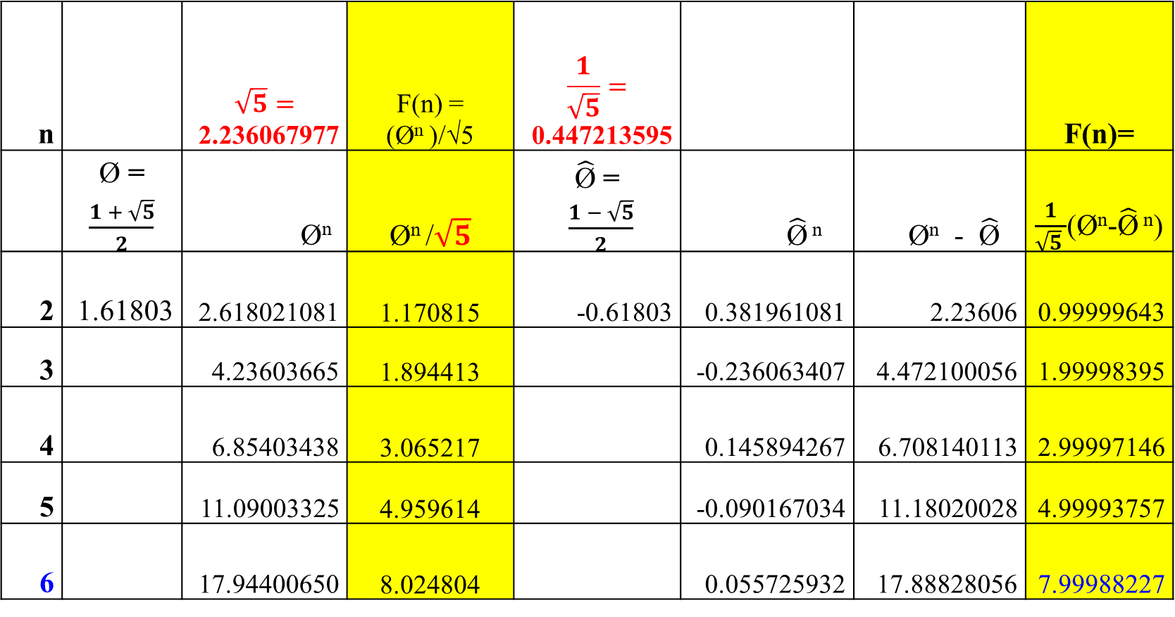
n |  | $$\sqrt{5}=$$ 2.236067977 | F(n) = (Ø^{n} )/√5 | $$\frac{1}{\sqrt{5}}=$$ 0.447213595 |  |  | F(n)=
 | Ø = $\frac{1 + \sqrt{5}}{2}$ | Ø^{n} | Ø^{n} /$\sqrt{5}$ | $\hat{\text{Ø}}$ = $\frac{1 − \sqrt{5}}{2}$ | $\hat{\text{Ø}}$ ^{n} | Ø^{n} - $\hat{\text{Ø}}$ | $\frac{1}{\sqrt{5} }$(Ø^{n}-$\hat{\text{Ø}}$ ^{n})
2 | 1.61803 | 2.618021081 | 1.170815 | -0.61803 | 0.381961081 | 2.23606 | 0.99999643
3 |  | 4.23603665 | 1.894413 |  | -0.236063407 | 4.472100056 | 1.99998395
4 |  | 6.85403438 | 3.065217 |  | 0.145894267 | 6.708140113 | 2.99997146
5 |  | 11.09003325 | 4.959614 |  | -0.090167034 | 11.18020028 | 4.99993757
6 |  | 17.94400650 | 8.024804 |  | 0.055725932 | 17.88828056 | 7.99988227
k=0 | 1 | 2 | 3 | 4 | 5 | 6 | 7 | 8 | 9 | 10 | 11 | 12 | 13
F=0 | 1 | 1 | 2 | 3 | 5 | 8 | 13 | 21 | 34 | 55 | 89 | 144 | 233

Slide 38
Mathematical Analysis of Recursive Algorithms
Another Method for Solving inhomogeneous Recurrence Relation
of Given Recursive Fibonacci Numbers Algorithm

Slide 39

Recall that we have treated Fibonacci Numbers Recurrence System as homogenous linear second-ordered recurrence with constant coefficients way.
Example 1.23: Fibonacci Numbers
Let rewrite the exponential algorithm function Fib1(n) as follows:
Algorithm Fibonacci_Number F(n)
//Using its definition, computes the nth Fibonacci number recursively. Input: A nonnegative integer n
Output: The nth Fibonacci number
if (n ≤ 1) return n;
else return F(n-1) + F(n-2);

Slide 40


A(n) – A(n-1) – A(n-2) = 0
r² - r - 1 = 0
Using case 2, A(n) = [(Ø ^{n} - $\hat{\text{Ø}}$^{n})/ √5].
Let A(c) = c.
c – c – c = 1
c = 1
c = -1
A(n) = [(Ø ^{n} - $\hat{\text{Ø}}$^{n})/ √5] - 1.
Analysis of the Algorithm
Consider that Algorithm Fibonacci_Number F(n)
if n ≤ 1 return n
else return F(n-1) + F(n-2);
Input size is n;
The basis operation is addition.
Let A(n) be the number of additions performed by the algorithm in computing F(n).
Then the numbers of additions needed for computing F(n-1) and F(n-2) are A(n-1) and A(n-2), respectively, and algorithm needs one more addition to compute their sum. Thus,
A(n) = A(n-1) + A(n-2) + 1 for n > 1.
A(0) = 0, A(1) = 0.

Slide 41

This inhomogeneous recurrence
A(n) – A(n-1) – A(n-2) = 1
is quite similar to recurrence
F(n) – F(n-1) – F(n-2) = 0,
but its right-hand side is not equal to zero.
[what are the differences between these two recurrence systems?]
[General techniques for solving inhomogeneous recurrences can be found in the section “Explicit Formula for the nth Fibonacci Number” of this copy of lecture note].

Slide 42
Consider A(n) = A(n-1) + A(n-2) + 1 for n > 1.
A(0) = 0, A(1) = 0.
Reduce this inhomogeneous recurrence A(n) – A(n-1) – A(n-2) = 1 to a homogeneous one by rewriting it as
[A(n) + 1] – [A(n-1) +1] – [A(n-2) + 1] = 0
and then substituting B(n) = A(n) + 1.
We obtain
B(n) – B(n-1) – B(n-2) = 0
B(0) = 1, B(1) = 1.
This homogeneous recurrence can be solved exactly in the same manner as the recurrence
F(n) – F(n-1) – F(n-2) = 0
F(0) = 0, F(1) = 01
which was solved to find an explicit formula for F(n).

Slide 43
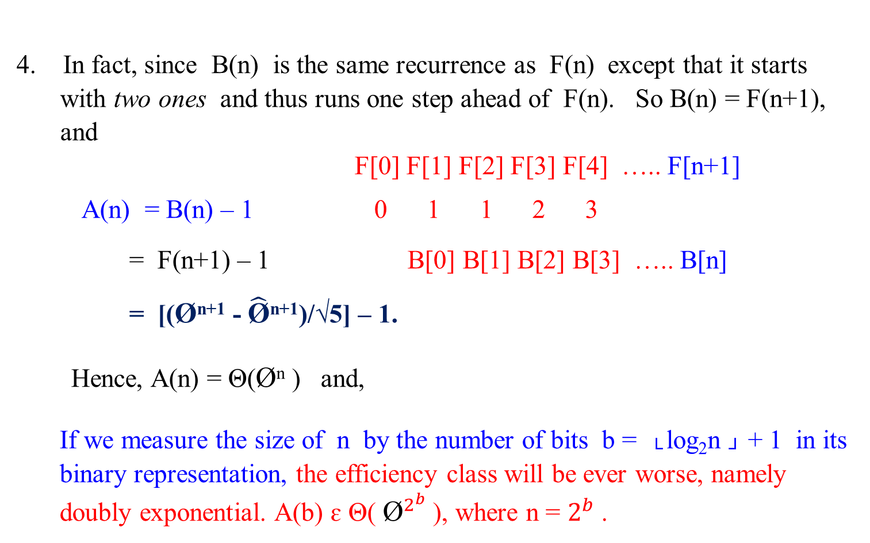
4. In fact, since B(n) is the same recurrence as F(n) except that it starts with two ones and thus runs one step ahead of F(n). So B(n) = F(n+1), and
F[0] F[1] F[2] F[3] F[4] ….. F[n+1]
A(n) = B(n) – 1 0 1 1 2 3
= F(n+1) – 1 B[0] B[1] B[2] B[3] ….. B[n]
= [(Ø^{n+1} - $\hat{\text{Ø}}$^{n+1})/√5] – 1.
Hence, A(n) = Θ(Ø^{n} ) and,
If we measure the size of n by the number of bits b = └ log₂n ┘ + 1 in its binary representation, the efficiency class will be ever worse, namely doubly exponential. A(b) ɛ Θ( ${\text{Ø}}^{2^{b}}$ ), where n = $2^{b}$ .

Slide 44
5. The poor efficiency class of the algorithm could be anticipated by the nature of recurrence. It contains two recursive calls with the sizes of smaller instances only slightly smaller than size n.
We also can see the reason behind the algorithm’s inefficiency by looking at a recursive tree of calls tracing the algorithm’s execution. An example of such a tree for n = 5 is given as follows:

Slide 45
F(5)
F(4) F(3)
F(3) F(2) F(2) F(1)
F(2) F(1) F(1) F(0) F(1) F(0)
F(1) F(0)
Figure 1.4: The recursion tree corresponding to the exponential Algorithm Fibonacci_Number F(n).
Note that the same values of the function are being evaluated again and again, which is clearly extremely inefficient.

Slide 46
6. Let obtain a much faster algorithm by simply computing the successive elements of the Fibonacci sequence iteratively, as is done in the following algorithm.
Show that B(n) = F(n +1).
Shown: Analysis via observation.
B(n) = A(n) +1
Let n = 0. Then B(0) = A(0) + 1 = 1 = F(1)
Let n = 1. B(1) = A(1) + 1 = 0 + 1 = 1 = F(2)
Let n = 2. B(2) = A(2) + 1
= A(1) + A(0) + 1 + 1
= 0 + 0 + 1 + 1 = 2 = F(3)
Let n = 3. B(3) = A(3) + 1
= A(2) + A(1) + 1 + 1
= A(1) + A(0) + 1 + 1 + 1
= 0 + 0 + 1 + 1 + 1 = 3 = F(4)
Let n = 4. B(4) = A(4) + 1
= 5 = F(5)
In general B(n) = F(n + 1).

Slide 47
6. Let obtain a much faster algorithm by simply computing the successive elements of the Fibonacci sequence iteratively, as is done in the following algorithm.
Show that B(n) = F(n +1).
Shown: Shown by induction.
B(n) = A(n) +1
Let n = 0. Then B(0) = A(0) + 1 = 1 = F(1)
Let n = 1. B(1) = A(1) + 1 = 0 + 1 = 1 = F(2)
Let n = 2. B(2) = A(2) + 1
= A(1) + A(0) + 1 + 1
= 0 + 0 + 1 + 1 = 2 = F(3)
In general B(n) = F(n + 1).
Assume that B(n-1) = F(n) and B(n -2) = F(n-1) are correct. Then
B(n) = A(n) + 1 since A(n) = B(n) – 1
B(n) = A(n -1) + A(n -2) + 1 + 1 since A(n) = A(n-1) + A(n-2) + 1 for n > 1
B(n) = A(n – 1) + 1 + A(n -2 ) + 1
B(n) = B(n -1 ) + B(n-2), since A(n) = B(n) – 1
B(n) = F(n) + F(n -1) using our assumption that B(n-1) = F(n) is correct.
B(n) = F(n + 1)

Slide 48
Mathematical Analysis of
Other Ways for Computing Fibonacci Numbers

Slide 49

Second way: A polynomial algorithm Fib2(n)
A much faster algorithm by simply computing the successive elements of the Fibonacci sequence iteratively, as is done in the following algorithm.
Let rewrite the exponential algorithm to be function Fib2(n), which is as follows:

Slide 50
Polynomial Algorithm Fib2(n)
//Computes the nth Fibonacci number iteratively by using its definition
Input: A nonnegative integer n
Output: The nth Fibonacci number
if (n == 0) then return 0;
create an array F[0 .. n];
F[0] ← 0; F[1] ← 1;
for ( i ← 2) to n do {
F[i] ← F[i-1] + F[i-2];}
return F[n];

Slide 51

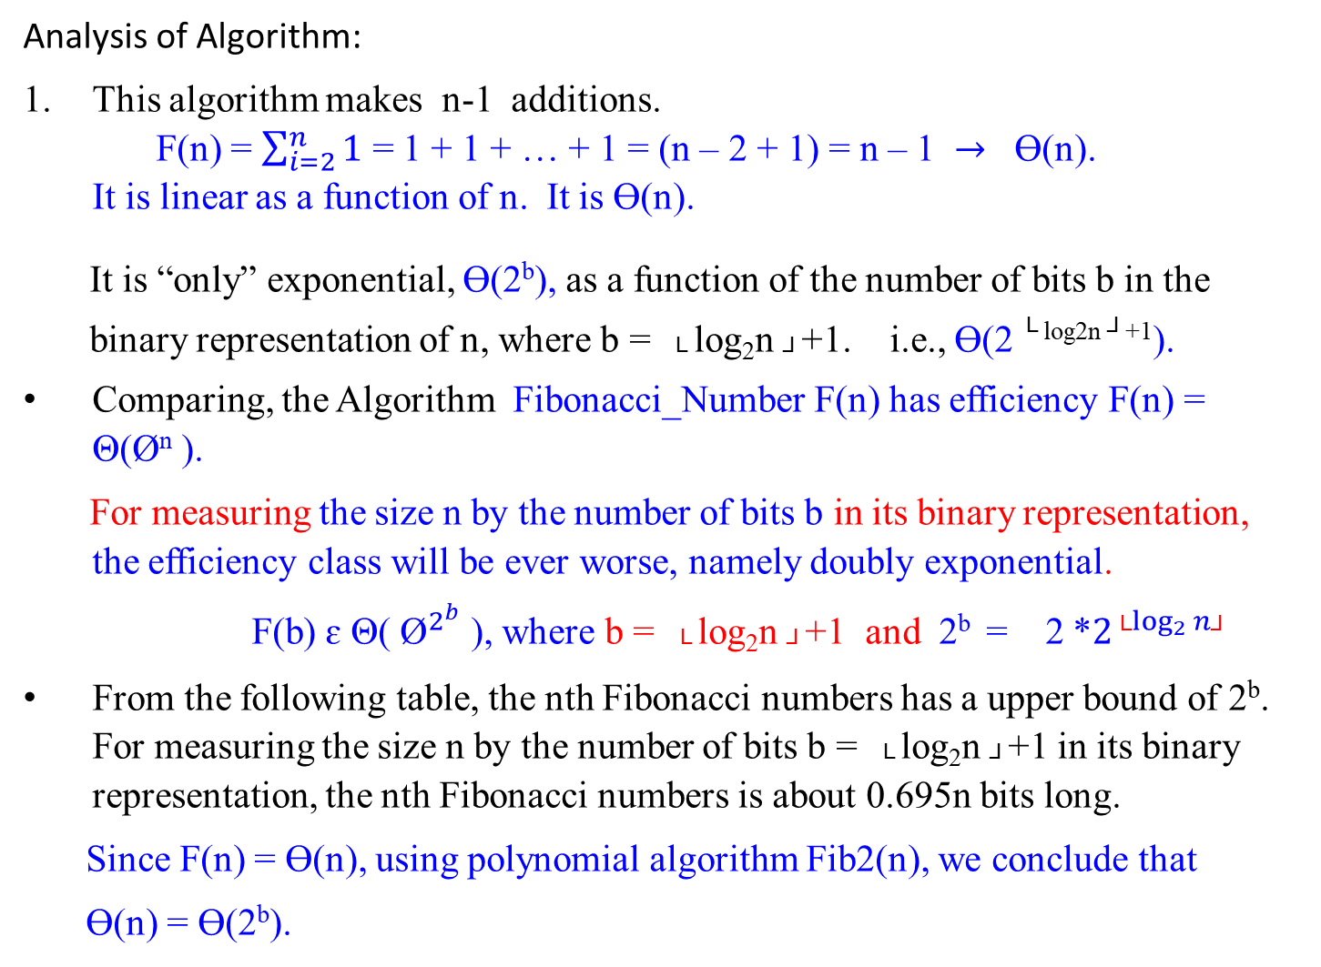
Analysis of Algorithm:
This algorithm makes n-1 additions.
F(n) = $\sum_{i=2}^{n}{1}$ = 1 + 1 + … + 1 = (n – 2 + 1) = n – 1 $→$ Ɵ(n).
It is linear as a function of n. It is Ɵ(n).
It is “only” exponential, Ɵ(2^{b}), as a function of the number of bits b in the
binary representation of n, where b = └ log₂n ┘+1. i.e., Ɵ(2 ^{└ log2n ┘+1}).
Comparing, the Algorithm Fibonacci_Number F(n) has efficiency F(n) = Θ(Ø^{n} ).
For measuring the size n by the number of bits b in its binary representation, the efficiency class will be ever worse, namely doubly exponential.
F(b) ɛ Θ( ${\text{Ø}}^{2^{b}}$ ), where b = └ log₂n ┘+1 and 2^{b} = 2 *$2^{{\text{└}log}_{2}{n\text{┘}}}$
From the following table, the nth Fibonacci numbers has a upper bound of 2^{b}. For measuring the size n by the number of bits b = └ log₂n ┘+1 in its binary representation, the nth Fibonacci numbers is about 0.695n bits long.
Since F(n) = Ɵ(n), using polynomial algorithm Fib2(n), we conclude that
Ɵ(n) = Ɵ(2^{b}).
:The magnitude of n

Slide 52
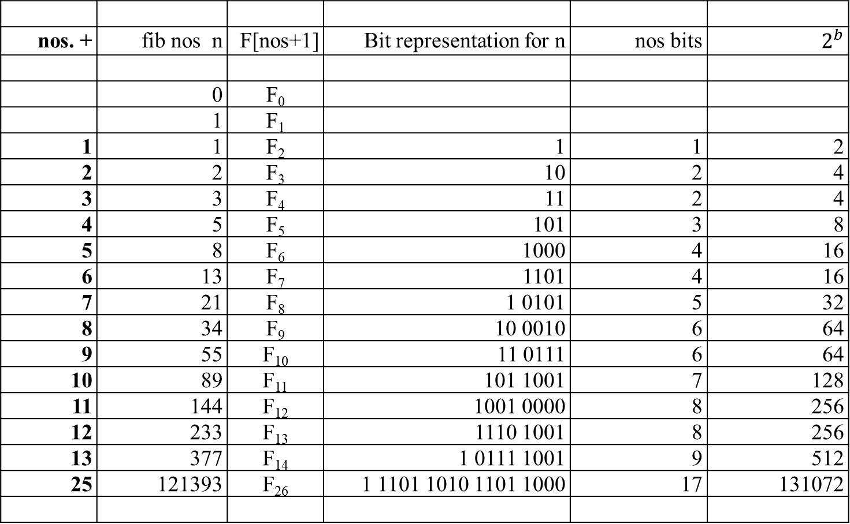
nos. + | fib nos n | F[nos+1] | Bit representation for n | nos bits | $$2^{b}$$
 | 0 | F₀
 | 1 | F₁
1 | 1 | F₂ | 1 | 1 | 2
2 | 2 | F₃ | 10 | 2 | 4
3 | 3 | F₄ | 11 | 2 | 4
4 | 5 | F₅ | 101 | 3 | 8
5 | 8 | F₆ | 1000 | 4 | 16
6 | 13 | F₇ | 1101 | 4 | 16
7 | 21 | F₈ | 1 0101 | 5 | 32
8 | 34 | F₉ | 10 0010 | 6 | 64
9 | 55 | F₁₀ | 11 0111 | 6 | 64
10 | 89 | F₁₁ | 101 1001 | 7 | 128
11 | 144 | F₁₂ | 1001 0000 | 8 | 256
12 | 233 | F₁₃ | 1110 1001 | 8 | 256
13 | 377 | F₁₄ | 1 0111 1001 | 9 | 512
25 | 121393 | F₂₆ | 1 1101 1010 1101 1000 | 17 | 131072

Slide 53
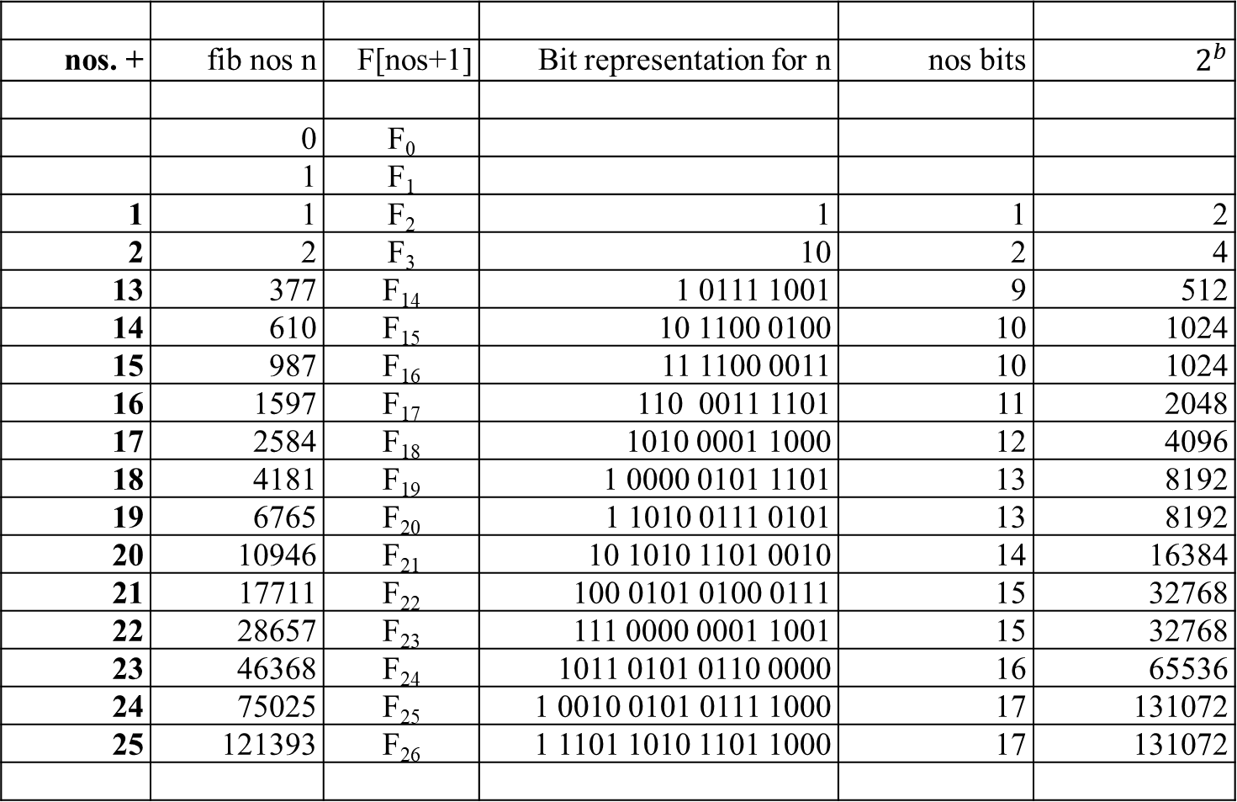
nos. + | fib nos n | F[nos+1] | Bit representation for n | nos bits | $$2^{b}$$
 | 0 | F₀
 | 1 | F₁
1 | 1 | F₂ | 1 | 1 | 2
2 | 2 | F₃ | 10 | 2 | 4
13 | 377 | F₁₄ | 1 0111 1001 | 9 | 512
14 | 610 | F₁₅ | 10 1100 0100 | 10 | 1024
15 | 987 | F₁₆ | 11 1100 0011 | 10 | 1024
16 | 1597 | F₁₇ | 110 0011 1101 | 11 | 2048
17 | 2584 | F₁₈ | 1010 0001 1000 | 12 | 4096
18 | 4181 | F₁₉ | 1 0000 0101 1101 | 13 | 8192
19 | 6765 | F₂₀ | 1 1010 0111 0101 | 13 | 8192
20 | 10946 | F₂₁ | 10 1010 1101 0010 | 14 | 16384
21 | 17711 | F₂₂ | 100 0101 0100 0111 | 15 | 32768
22 | 28657 | F₂₃ | 111 0000 0001 1001 | 15 | 32768
23 | 46368 | F₂₄ | 1011 0101 0110 0000 | 16 | 65536
24 | 75025 | F₂₅ | 1 0010 0101 0111 1000 | 17 | 131072
25 | 121393 | F₂₆ | 1 1101 1010 1101 1000 | 17 | 131072

Slide 54
Analysis of Algorithm (Continued):
Avoid to use an extra array for storing all the preceding elements of the Fibonacci sequence:
storing just two values is necessary to accomplish the task.
3. The inner loop consists of a single computer step and is executed n-1 times. Therefore the number of computer steps used by Fib2 is linear in n.

Slide 55

The third alternative for computing the nth Fibonacci number lies in using formula. For every nonnegative integer n,
F(n) = (Ø^{n} )/√5 rounded to the nearest integer,
where Ø = (1 + √5)/2 ≈ 1.61803.
Analysis of this Algorithm:
The efficiency of the algorithm will obviously be determined by the efficiency of an exponentiation algorithm used for computing Ø^{n}.
2. But, if it is done by simply multiplying Ø by itself n-1 times, the algorithm will be in Θ(n) = Θ(2^{b} ).

Slide 56
Note that there are faster algorithms for the exponentiation problem.
For example we discuss Θ(log n) = Θ(b) algorithms for this problem in our lectures dealing with Decrease-and-Conquer and Transform-and-Conquer.
Note that special care should be exercised in implementing this approach to computing the nth Fibonacci number. Since all its intermediate results are irrational numbers, we would have to make sure that their approximations in the computer are accurate enough so that the final round-off yields a correct result.

Slide 57
The Fourth Approach for computing Fibonacci number Fib3:
Finally, there exists a Θ(log n) algorithm Fib3 for computing the nth Fibonacci number that manipulates only integers.
It is based on the equality
F(n-1) F(n) 0 1 ^{n}
= for n ≥ 1
F(n) F(n+1) 1 1
and an efficient way of computing matrix powers.
A question is that how do you compute 2 x 2 matric powers in a fastest way.

Slide 58

Consider the equation F₁ = F₁ and F₂ = F₀ + F₁ in matrix notation:
F₁ 0 1 F₀
=
F₂ 1 1 F₁
0 F₀ + 1 F₁ F₁
= =
1 F₀ + 1 F₁ F₀ + F₁
Similarly,
F₂ 0 1 F₁ 0 1 ² F₀
= =
F₃ 1 1 F₂ 1 1 F₁

Slide 59

In general Fib3 can be expressed as:
F_{n}
0 1 ^{n} F₀
=
F_{n+1}
1 1 F₁
In order to compute F_{n}, it suffices to raise the 2 x 2 matrix, call it X, to the nth power. The question is how do you compute matrix multiplication X^{n} in O(log n).

Slide 60

a b
Consider a 2 x 2 matrix
c d
a b ² a b a b a*a + b*c a*b + b*d
= =
c d c d c d c*a + d*c c*b + d*d
Two 2 x 2 matrices can be multiplied using 4 additions and 8 multiplications.

Slide 61
a b ³ a b ² a b
=
c d c d c d
a*a + b*c a*b + b*d a b
=
c*a + d*c c*b + d*d c d
a*(a*a + b*c) + c*(a*b + b*d) b*(a*a + b*c) + d*( a*b + b*d)
=
a*( c*a + d*c) + c*(c*b + d*d) b*( c*a + d*c) + d*(c*b + d*d)
Three 2x2 matrices can be multiplied using 8 additions and 16 multiplications.

Slide 62

a b ⁴ a b ³ a b
=
c d c d c d
a*(a*a + b*c) + c*(a*b + b*d) b*(a*a + b*c) + d*( a*b + b*d) a b
=
a*( c*a + d*c) + c*(c*b + d*d) b*( c*a + d*c) + d*(c*b + d*d) c d
a*( a*(a*a + b*c) + c*(a*b + b*d)) b*( a*(a*a + b*c) + c*(a*b + b*d))
+c*(b*(a*a + b*c) + d*(a*b + b*d)) +d*(b*(a*a + b*c) + d*(a*b + b*d))
=
a*(a*(c*a + d*c) + c*(c*b + d*d)) b*(a*(c*a + d*c) + c*(c*b + d*d))
+c*(b*(c*a + d*c) + d*(c*b + d*d)) +d*(b*(c*a + d*c) + d*(c*b + d*d))
Four 2x2 matrices can be multiplied using 12 additions and 24 multiplications.

Slide 63

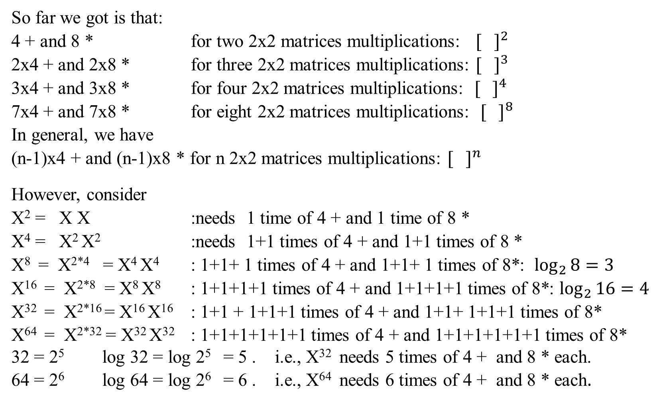
So far we got is that:
4 + and 8 * for two 2x2 matrices multiplications: $[ ]^{2}$
2x4 + and 2x8 * for three 2x2 matrices multiplications: $[ ]^{3}$
3x4 + and 3x8 * for four 2x2 matrices multiplications: $[ ]^{4}$
7x4 + and 7x8 * for eight 2x2 matrices multiplications: $[ ]^{8}$
In general, we have
(n-1)x4 + and (n-1)x8 * for n 2x2 matrices multiplications: $[ ]^{n}$
However, consider
X² = X X :needs 1 time of 4 + and 1 time of 8 *
X⁴ = X² X² :needs 1+1 times of 4 + and 1+1 times of 8 *
X⁸ = X^{2*4} = X⁴ X⁴ : 1+1+ 1 times of 4 + and 1+1+ 1 times of 8*: $\log_{2}{8=3}$
X¹⁶ = X^{2*8} = X⁸ X⁸ : 1+1+1+1 times of 4 + and 1+1+1+1 times of 8*: $\log_{2}{16=4}$
X³² = X^{2*16} = X¹⁶ X¹⁶ : 1+1 + 1+1+1 times of 4 + and 1+1+ 1+1+1 times of 8*
X⁶⁴ = X^{2*32} = X³² X³² : 1+1+1+1+1+1 times of 4 + and 1+1+1+1+1+1 times of 8*
32 = 2⁵ log 32 = log 2⁵ = 5 . i.e., X³² needs 5 times of 4 + and 8 * each.
64 = 2⁶ log 64 = log 2⁶ = 6 . i.e., X⁶⁴ needs 6 times of 4 + and 8 * each.

Slide 64
32 = 2⁵ log 32 = log 2⁵ = 5 . i.e., X³² needs 5 times of 4 + and 8 * each.
64 = 2⁶ log 64 = log 2⁶ = 6 . i.e., X⁶⁴ needs 6 times of 4 + and 8 * each.
For compute X^{n}, we have the formula:
(X^{n/2})² if n is even and positive
X^{n} = (X^{(n-1)/2})² * X if n is odd
1 if n = 0
If we compute X^{n} recursively according to this formula and measure the algorithm’s efficiency by the number of multiplications, we should expect the algorithm to be Ɵ(log n) because, on each iteration, the size is reduced by about a half at the expense of one or two multiplication. This is one of the example of the decrease-by-a-constant-factor (or the decrease-by-half) technique.

Slide 65
Thus, the number of arithmetic operations needed by our matrix-based algorithm Fib3 is just O(log n), as compared to O(n) for Fib2. Have we broken another exponential barrier?
The catch is that our new algorithm Fib3 involves
multiplication, not just addition; and
multiplications of large numbers are slower than additions.
When the complexity of arithmetic operations is taken into account, the running time of Fib3 becomes O(n²).

Slide 66

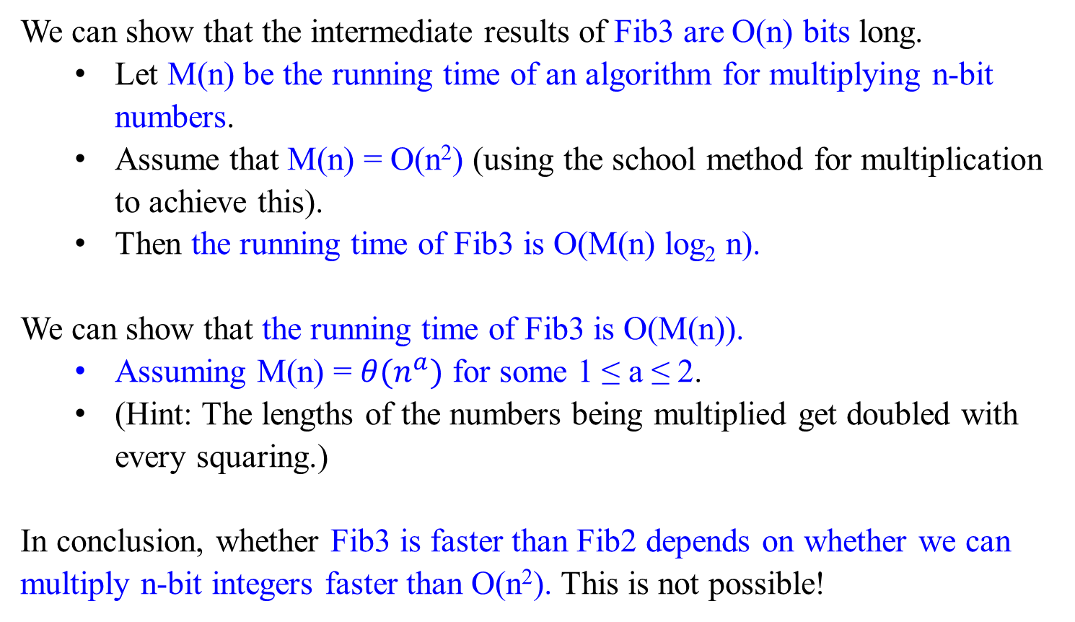
We can show that the intermediate results of Fib3 are O(n) bits long.
Let M(n) be the running time of an algorithm for multiplying n-bit numbers.
Assume that M(n) = O(n²) (using the school method for multiplication to achieve this).
Then the running time of Fib3 is O(M(n) log₂ n).
We can show that the running time of Fib3 is O(M(n)).
Assuming M(n) = $θ(n^{a})$ for some 1 ≤ a ≤ 2.
(Hint: The lengths of the numbers being multiplied get doubled with every squaring.)
In conclusion, whether Fib3 is faster than Fib2 depends on whether we can multiply n-bit integers faster than O(n²). This is not possible!

Slide 67

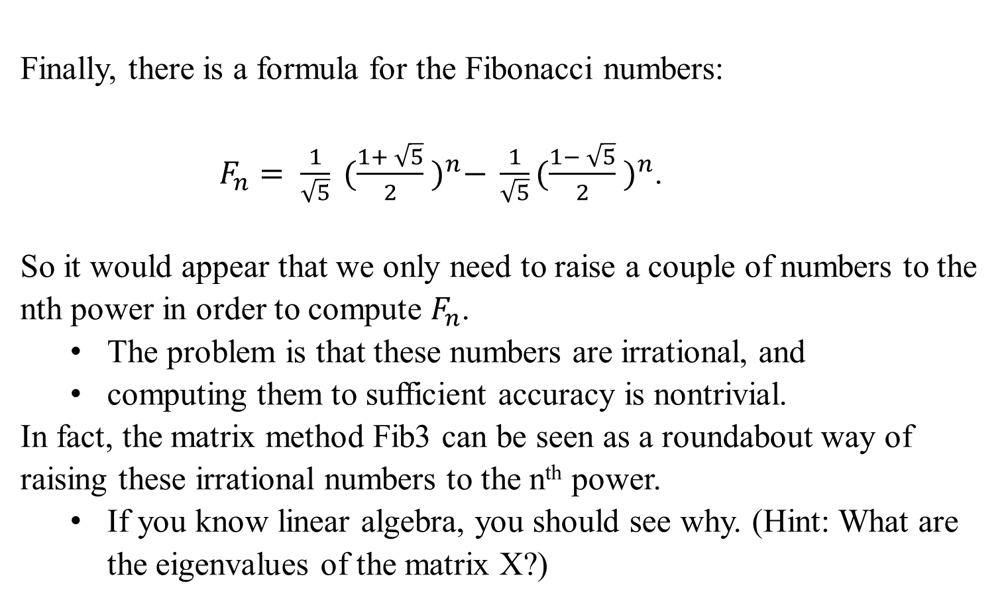
Finally, there is a formula for the Fibonacci numbers:
$F_{n}= \frac{1}{\sqrt{5}} {(\frac{1+ \sqrt{5}}{2} )}^{n}− \frac{1}{\sqrt{5}}{(\frac{1− \sqrt{5}}{2} )}^{n}$.
So it would appear that we only need to raise a couple of numbers to the nth power in order to compute $F_{n}$.
The problem is that these numbers are irrational, and
computing them to sufficient accuracy is nontrivial.
In fact, the matrix method Fib3 can be seen as a roundabout way of raising these irrational numbers to the n^{th} power.
If you know linear algebra, you should see why. (Hint: What are the eigenvalues of the matrix X?)

Slide 68
Remark:
The Fibonacci numbers were introduced by Leonardo Fibonacci in 1202 as a solution to a problem about the size of a rabbit population.
Many more examples of Fibonacci-like numbers have since been discovered in the natural world, and they have even been used in predicting the prices of stocks and commodities.
The worst-case inputs for Euclid’s algorithm happen to be consecutive elements of the Fibonacci sequence.
Euclid’s Algorithm is based on applying repeated the equality
gcd(m, n) = gcd(n, m mod n).
This is a typical example of the variable-size-decrease of decrease-and-conquer.

